Slide 1


Systems Analysis & Design
Eleventh Edition
Chapter # 5
Information Gathering: Unobtrusive Methods
Copyright © 2024, 2019, 2014 Pearson Education, Inc. All Rights Reserved
Notes:
If this PowerPoint presentation contains mathematical equations, you may need to check that your computer has the following installed:
1) MathType Plugin
2) Math Player (free versions available)
3) NVDA Reader (free versions available)
Slides in this presentation contain hyperlinks. JAWS users should be able to get a list of links by using INSERT+F7

Slide 2
Learning Objectives (1 of 2)
5.1 Learn how to construct useful samples of people, documents, and events.
5.2 Learn how to analyze quantitative documents with the goal of improving their design.
5.3 Analyze qualitative documents for useful clues that will help you understand the current situation.
5.4 Be able to interpret managers and customers’ messages, interviews, and communications using text analytics.
5.5 Understand what process mining is and how it can be used to determine any bottlenecks, variations, or exceptions

Slide 3
Learning Objectives (2 of 2)
5.6 Learn how workplace analytics can monitor and improve on worker and team participation.
5.7 Observe decision makers’ behavior and create an analyst’s playscript to observe decision makers’ activities.
5.8 Observe the physical environment by applying the S T R O B E technique to observe and interpret.

Slide 4
Unobtrusive Methods
Less disruptive
Text analytics to analyze qualitative data
Insufficient when used alone
Multiple methods approach
Used in conjunction with interactive methods
Notes:
Unobtrusive methods:
sampling
investigation
observing
Multiple methods approach—using unobtrusive methods in conjunction with interactive methods. This is called multiple methods approach.
Using both interactive and unobtrusive methods will result in a more complete picture of human information requirements.

Slide 5
Major Topics
Sampling
Quantitative document analysis
Qualitative document analysis
Text analytics
Process mining
Workforce analytics
Observation
S T R O B E

Slide 6
Sampling (1 of 2)
A process of systematically selecting representative elements of a population
Involves two key decisions:
  What to examine
  Which people to consider
Notes:
By selecting a representative population the analyst can reveal useful information about the population as a whole.
What to examine—which documents of the many reports, forms, output documents, memos, and Web sites that have been generated by people in the organization should be considered?
Which people to consider—which people should be selected to represent the population as a whole?

Slide 7
Need for Sampling (1 of 2)
The reasons systems analysts do sampling are to
  Contain costs
  Speed up data gathering
  Improve effectiveness
  Data gathering bias can be reduced by sampling
Notes:
Containing costs:
examining every document, talking to everyone, and reading every Web page would be too costly.
employee time, copying reports, and duplicating unnecessary reports would be an added expense
Speeding up the data gathering—sampling speeds up the process by examining a smaller population which in turn reduces the amount of data that needs to be analyzed.
Improving effectiveness—by examining a sample of the population more detailed questions can be answered and followed up on thus improving the effectiveness of data gathering
Reducing bias since the information gathered would not be restricted to only one person

Slide 8
Need for Sampling (2 of 2)
Too costly to
  Examine every scrap of paper
  Talk with everyone
  Read every Web page from the organization

Slide 9
Sampling (2 of 2)
Sampling helps accelerate the process by gathering selected data rather than all data for the entire population
The systems analyst is spared the burden of analyzing data from the entire population

Slide 10
Sampling Effectiveness
Sampling can help improve effectiveness if information that is more accurate can be obtained
This is accomplished by talking to fewer employees but asking them questions that are more detailed
If fewer people are interviewed, the systems analyst has more time to follow up on missing or incomplete data

Slide 11
Sampling Bias
Data gathering bias can be reduced by sampling
When the systems analyst asks for an opinion about a permanent feature of the installed information system, the executive interviewed may provide a biased evaluation because there is little possibility of changing it

Slide 12
Sampling Design
To design a good sample, a systems analyst must follow four steps:
  Determining the data to be collected or described
  Determining the population to be sampled
  Choosing the type of sample
  Deciding on the sample size
Notes:
Determining the data to be collected or described—if irrelevant data are gathered, then time and money are wasted in the collection, storage, and analysis of useless data.
Determining the population to be sampled—must determine what the population is.
Choosing the type of sample—there are four types of samples: convenience, purposive, simple, and complex.
convenience samples—unrestricted, nonprobability samples, easiest to arrange but also the most unreliable
purposive samples—based on judgment, moderately reliable
simple—need a numbered list of the population to ensure an equal chance of being selected, often not practical
complex random samples:
systematic—example might be to select every kth person
stratified—process of identifying subpopulations, or strata, and then selecting from these subpopulations
cluster—select a group representative of all the groups of that type
Deciding on the sample size—needs to be greater then 1 but less than the size of the population itself. The absolute number is more important then the percentage of the population.

Slide 13
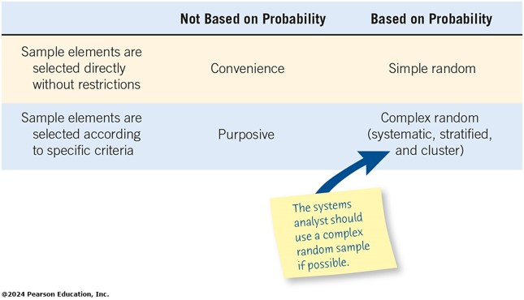
Figure 5.1 Four Main Types of Samples A System Analyst Has Available
Notes:
Long Description:
The table shows information in three columns, with the first column listing how sample elements are chosen and the other two headings reading not based on probability; and based on probability. The information depicted is as follows.
1. Sample elements are selected directly without restrictions: Convenience; Simple random.
2. Sample elements are selected according to specific criteria: Purposive, Complex random (systematic, stratified, and cluster)

Slide 14
Four Main Types of Samples
Convenience
Purposive
Simple random
Complex random

Slide 15
Convenience Samples
Convenience samples are unrestricted, nonprobability samples
This sample is the easiest to arrange
The most unreliable

Slide 16
Purposive Sample
A purposive sample is based on judgment
Choose a group of individuals who appear knowledgeable and are interested in the new information system
A nonprobability sample
Only moderately reliable

Slide 17
Complex Random Samples
The complex random samples that are most appropriate for a systems analyst are
  Systematic sampling
  Stratified sampling
  Cluster sampling

Slide 18
The Sample Size Decision
Determine the attribute
Locate the database or reports in which the attribute can be found
Examine the attribute
Make the subjective decision regarding the acceptable interval estimate
Choose the confidence level
Calculate the standard error
Determine the sample size
Notes:
The sample size often depends on the cost involved or the time required by the systems analysts, or even the time available by people in the organization.
Determine the attribute—determine the attribute to sample.
Locate the database or reports in which the attribute can be found—find out where the data is stored; database, on a form, or in a report.
Examine the attribute—estimate ρ, the proportion of the population having the attribute. A value of .10 generally results in an acceptable sample size.
Make the subjective decision regarding the acceptable interval estimate—this is purely a subjective decision. An interval estimate (i) of ± .10 means an error of no more than 0.10 in either direction from the actual proportion, ρ.
Choose the confidence level—the desired degree of certainty and then look up the confidence coefficient level (z value) in a table.

Slide 19
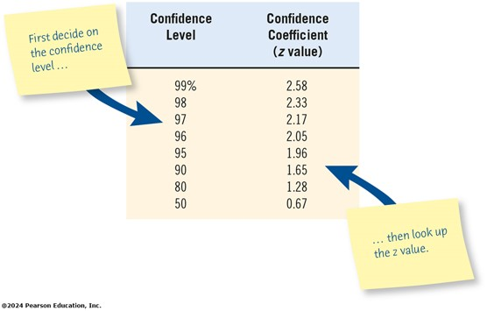
Figure 5.2 A System Analysis can use a Table of Area under a Normal Curve to Look up a Value Once the Confidence Level is Decided
Notes:
The choice of the confidence level is purely subjective. It is the desired degree of certainty.
Long Description:
The table shows information in two columns, Confidence Level and Confidence Coefficient (z value). The information depicted is:
99 percent; 2.58
98; 2.33
97; 2.17
96; 2.05
95; 1.96
90; 1.65
80; 1.28
50; 0.67
A note on the table reads, first decide on the confidence level and then look up the z value.

Slide 20
Calculate the Standard Error of the Proportion
i = interval estimate
z = confidence coefficient found in the confidence level lookup table

Slide 21
Determine the Sample Size
standard error
the proportion of the population having the attribute

Slide 22
Example: A. Sembly Company
Determine that you are looking for orders with mistakes
Locate order forms from the past six months
Examine order forms and conclude that p = 5%
Subjective decision of acceptable interval
Look up confidence coefficient z - value = 1.96
Calculate
Determine n; n = 458
Notes:
The higher the confidence level the larger the sample size. If we increase the confidence level from 95 to 99% the sample size would increase from 458 to 1,827.

Slide 23
Investigation
The act of discovery and analysis of data
Hard data
  Quantitative
  Qualitative
Notes:
Hard data reveal where the organization has been and where its members believe it is going.

Slide 24
Analyzing Quantitative Documents
Reports used for decision making
Performance reports
Records
Data capture forms
Ecommerce and other transactions
Notes:
All these documents have a specific purpose and audience for which they are targeted.

Slide 25
Reports Used for Decision Making
Sales reports
Production reports
Summary reports
Notes:
Sales reports—summarize the amount sold and the type of sales. They might include graphical output comparing revenue and income over a set number of periods.
Production reports—include recent costs, current inventory, recent labor, and plant information.
Summary reports—provide background information, spot exceptions to normal occurrences, and afford strategic overviews of organizational plans.

Slide 26
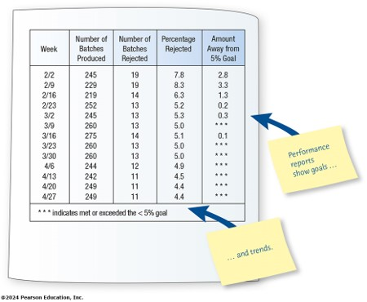
Figure 5.3 A Performance Report Showing Improvement
Notes:
Long Description:
The table shows information in five columns, week, number of batches produced, number of batches rejected, percentage rejected, and amount away from 5 percent goal.
2 of 2: 245: 19: 7.8: 2.8
2 of 9: 229: 19: 8.3: 3.3
2 of 16: 219: 14: 6.3: 1.3
2 of 23: 252: 13: 5.2: 0.2
3 of 2: 245: 13: 5.3: 0.3
3 of 9: 260: 13: 5.0: asterisk
3 of 16: 275: 14: 5.1: 0.1
3 of 23: 260: 13: 5.0: asterisk
3 of 30: 260: 13: 5.0: asterisk
4 of 6: 244: 12: 4.9: asterisk
4 of 13: 242: 11: 4.5: asterisk
4 of 20: 249: 11: 4.4: asterisk
4 of 27: 249: 11: 4.4: asterisk
Asterisk indicates met or exceeded the less than 5 percent goal.
A note pointing to the final column reads, performance reports shows goals ellipsis, and one pointing to the note concerning asterisk reads ellipsis and trends.

Slide 27
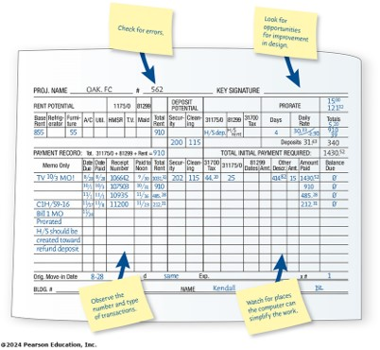
Figure 5.4 A Manually Completed Payment Record
Notes:
Ways to inspect a record:
checking for errors in amounts and totals
looking for opportunities for improving the recording form design
observing the number and type of transaction
watching for instances in which the computer can simplify the work
Long Description:
A manual report shows information in a complex tabular report with many blank cells. For the report itself, see table tab.
A note pointing to the project number says check for errors. A second note says to look for opportunities for improvement in design. The lower part of the table has a note attached, reading observe the number and type of transactions, and another reads, watch for places the computer can simplify the work.

Slide 28
Records
Records provide periodic updates of what is occurring in the business
There are several ways to inspect a record:
  Checking for errors in amounts and totals
  Looking for opportunities for improving the recording form design
  Observing the number and type of transactions
  Watching for instances in which the computer can simplify the work (calculations and other data manipulation)

Slide 29
Data Capture Forms
Collect examples of all the forms in use
Note the type of form
Document the intended distribution pattern
Compare the intended distribution pattern with who actually receives the form
Notes:
Blank forms can be compared with filled-in forms to:
see if any data items are consistently left blank
see if the people who are supposed to receive the forms actually do
see if standard procedures for using, storing, and discarding them are followed

Slide 30
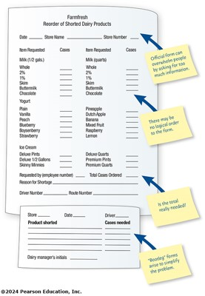
Figure 5.5 Questions to Ask about Official and Bootleg Forms That Are Already Filled out
Notes:
Is the form filled out in its entirety?
Are there forms that are never used? Why?
Are all copies of forms circulated to the proper people or filled appropriately? If not, why not?
If there is a paper form that is offered as an alternative to a Web-based form, compare the completion rates for both.
Are “unofficial” forms used on a regular basis?
Long Description:
The notes attached to the form read as follows. Official form can overwhelm people by asking for too much information. There may be no logical order to the form. Is the total really needed? These are attached to a complex form for reordering shorted dairy products that lists various kinds of milk in both half gallons and quarts, yogurt in a dozen flavors, six varieties of ice cream, and information about the date, the store name, the store number, the employee number of the requester, total cases ordered, reason for shortage, and driver and route numbers. Below the original complex form is a simpler one, with a note reading, bootleg, forms arise to simplify the problem. It includes spaces for the store, date, and driver, blank lists for products shorted and cases needed, and the manager's initials.

Slide 31
Questions to Ask about Forms
Is the form filled out in its entirety?
Are there forms that are never used?
Are all copies of forms circulated to the proper people or filed appropriately?
Check on permissions and functioning form links.
Can people who must access online forms do so?
If there is a paper form that is offered as an alternative to a Web-based form, compare the completion rates for both.
Are “unofficial” forms being used on a regular basis?

Slide 32
Analyzing Qualitative Documents (1 of 2)
Key or guiding metaphors
Insiders versus outsiders mentality
What is considered good versus evil
Graphics, logos, and icons in common areas or web pages
Sense of humor
Notes:
Includes email messages, memos, signs on bulletin boards and in the work areas, Web pages, procedure manuals, and policy handbooks.

Slide 33
Analyzing Qualitative Documents (2 of 2)
Email messages
Memos
Signs or posters on bulletin boards
Corporate Web sites (note the interactivity of Web sites)
Manuals
Policy handbooks
Notes:
Corporate Web sites—examine the contents for metaphors, humor, use of design features, and the meaning and clarity of any messages provided.
Manuals—present the “idea,” the way machines and people are expected to behave.
Policy handbooks—allows the systems analyst to gain an awareness of the values, attitudes, and beliefs guiding the company.

Slide 34
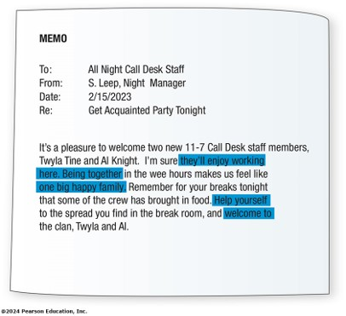
Figure 5.6 Analysis of Memos Provides Insight into the Metaphors That Guide the Organization’s Thinking
Notes:
Memos reveal a lively, continuing dialogue in the organization.
Long Description:
Memo.
To: All Night Call Desk Staff
From: S. Leep, Night Manager
Date: 2/15/2018
Re: Get Acquainted Party Tonight
It’s a pleasure to welcome two new 11-7 Call Desk staff members, Twyla Tine and Al Knight. I’m sure they’ll enjoy working here. Being together in the wee hours makes us feel like one big happy family. Remember for your breaks tonight that some of the crew has brought in food. Help yourself to the spread you find in the break room, and welcome to the clan, Twyla and Al.
The text highlighted in the above memo is they’ll enjoy working here, being together, one big family, help yourself, and welcome to.

Slide 35
Text Analytics (1 of 3)
Software that can analyze unstructured qualitative data from any source including:
  Transcripts of interviews
  Written reports
  Customers’ communication collected through email, wikis, blogs, chat rooms, and other social networking sites

Slide 36
Text Analytics (2 of 3)
Unstructured, qualitative, or “soft” data are generated through:
  Blogs
  Chat rooms
  Questionnaires using open-ended questions
  Online discussions conducted on the Web
  Exchanges occurring on social media

Slide 37
Text Analytics Can Help
Text analytics can realize valuable insights into
  What customers are thinking about the organization, the values and actions of the company
  Customer or vendor motivations for beginning, maintaining, improving, or discontinuing a relationship

Slide 38
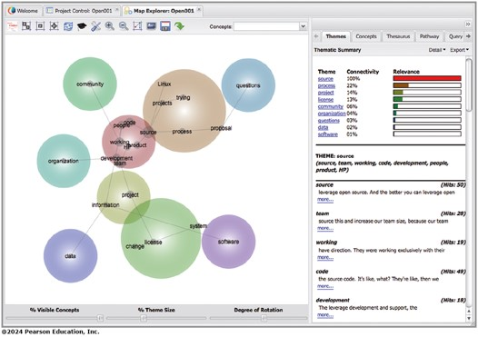
Figure 5.7 Concept Map Showing Prominence and Relationships of Concepts
Notes:
Long Description:
The illustration shows concepts in main area of the screen depicted in spheres. It shows the relationships between different concepts, with multiple interconnections among them. The right pane of the screen shows five tabs, themes, concepts, thesaurus, pathway and query. Themes tab is selected and shows a thematic summary showing information in three columns, theme, connectivity and relevance; and theme: source (source, team, working, code, development, people, product, H P) information.

Slide 39
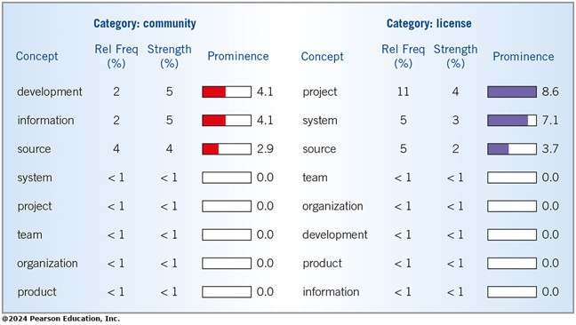
Figure 5.8 Ranked Concepts for Categories Overview
Notes:
Long Description:
The illustration shows two categories, community and license. Both categories show a table with four columns, with column heads concept, relative frequency (in percent), strength (in percent) and prominence. The information depicted is as follows.
1. Category: community
Row 1, development; 2; 5; 4.1. A horizontal bar is highlighted up to little less than a half.
Row 2, information; 2; 5; 4.1. A horizontal bar is highlighted up to little less than a half.
Row 3, source; 4; 4: 2.9. A horizontal bar is highlighted up to about one fourth.
Row 4, system: less than 1: less than 1: 0.0. A horizontal bar is blank.
Row 5, project: less than 1: less than 1: 0.0. A horizontal bar is blank.
Row 6, team; less than 1; less than 1: 0.0. A horizontal bar is blank.
Row 7, organization; less than 1; less than 1; 0.0. A horizontal bar is blank.
Row 8, product; less than 1; less than 1; 0.0. A horizontal bar is blank.
2. Category: license
Row 1, project; 11; 4; 8.6. A horizontal bar is highlighted completely.
Row 2, system; 5; 3; 7.1. A horizontal bar is highlighted to a little less than complete.
Row 3, source; 5; 2; 3.7. A horizontal bar is highlighted to a little less than half.
Row 4, team; less than 1; less than 1; 0.0. A horizontal bar is blank.
Row 5, organization; less than 1; less than 1; 0.0. A horizontal bar is blank.
Row 6, development; less than 1; less than 1: 0.0. A horizontal bar is blank.
Row 7, product; less than 1; less than 1; 0.0. A horizontal bar is blank.
Row 8, information; less than 1: less than 1: 0.0. A horizontal bar is blank.

Slide 40
Text Analytics (3 of 3)
Text analytics provide insights for an organization’s members who want to have a rapid and visual yet decidedly qualitative approach to analyzing text data
An important element is to design the human activities surrounding the use of text analytics software

Slide 41
Process Mining
Automated, unobtrusive process that scans processes from enterprise transaction systems (A P I s) and provides detailed and data-driven information about how key processes are performing and where problems may exist
Notes:
There are several organizations that provide process mining applications on the market.
Using process mining software, analysis can be done automatically reducing costs and saving time.

Slide 42
Four Steps to Process Mining (U I Path.com)
Discover
Optimize/Automate
Monitor
Act
Notes:
According to UIPath.com, there are four steps to process mining.
In the Discovery step, the process-mining app reads the data collected and creates an event log which tracks what event happened and when.
In the Optimize/Automate step, improvement takes place.
In the Monitor step, the systems analyst observes and determines what effect the optimize/automate phase had on the path.
The last step, Act, gives the company the incentive to move forward with any changes that are needed based on the previous steps.

Slide 43
Celonis Process Mining
Celonis process mining can help organizations by enabling analysts to:
  conduct an analysis of root causes of wastefulness and inefficiencies in processes
  recommend improvements to organizations that mitigate identified wastefulness and inefficiencies
  provide the quantifiable impacts of proposed changes on the organization
Notes:
Celonis is the leading organization in process mining controlling 60 percent of the market.
Celonis defines process mining as “an analytical discipline for discovering, monitoring, and improving business processes as they actually are-not as you think they might be.”

Slide 44
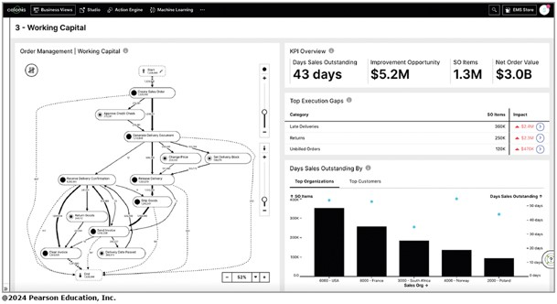
Figure 5.9 Screen from Celonis Software Shows Bottlenecks in the Process
Notes:
The process shown is too complicated and may be causing delays, returns, and billing issues.
Long Description:
The title of the page is 3, Working capital. The left pane shows the diagram starting with create sales order, going down vertically and in branches through various process of approve credit check, generate delivery document, change price, set delivery block, release delivery, receive delivery confirmation, ship goods, return goods, send invoice, clear invoice, delivery date passed, and end.
The right pane shows The K P I overview as follows. Days sales outstanding, 43 days. Improvement opportunity, 5.2 million dollars. S O items, 1.3 million. Net order value, 3.0 billion dollars. A bar graph for days sales outstanding by the top organizations of different countries is shown. The data depicts the following information. Sales organization, S O items, Days sales outstanding.
6000 U S A, 350,000, 48 days.
8000 France, 250,000, 38 days.
3000 South Africa, 198,000, 29 days.
4000 Norway, 120,000, 20 days.
2000 Poland, 100,000, 14 days.
All values are approximates.

Slide 45
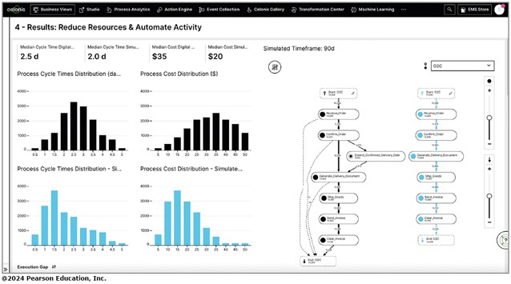
Figure 5.10 Simulation from Celonis Software Shows the Results of Removing Bottlenecks
Notes:
Long Description:
The title of the page is 4, results, reduce resources and automate activity. Four bar graphs are shown on the left panel. The vertical axis of all the graphs ranges from 0 to 4000 in increments of 1000 and the horizontal axis ranges from 0.5 to 5 in increments of 0.5. The first graph is titled, process cycle times distribution, the second graph is process cost distribution in dollars, the third graph is process cycle times distribution, simulated, and the fourth is process cost distribution, simulated. The right panel shows two process diagrams.

Slide 46
Task Mining
Uses desktop capture to automatically see what individuals are doing and figure out what processes can be improved
Notes:
Examples of popular task-mining software include Microsoft Viva, Allactivity, and Activtrak.
When used side-by-side with process mining and task mining are valued ways to keep systems running smoothly,

Slide 47
Workforce Analytics (1 of 2)
Ensuring the right workers in the right place
Balancing workload
Comparing workers or team’ performance
Understanding bottlenecks in workflow
Determining usage of apps
Realizing which apps are most productive
Notes:
Workforce analytics have become more sophisticated and revealing allowing managers the ability to automate collecting information about workloads and performance.

Slide 48
Workforce Analytics (2 of 2)
Should not be about surveillance or spying
Should be used to
  collect data to gain insight on how work is done
  determine the best tools and apps to get work done
  understand how teams interact
  identify where improvements can be made
Notes:
For managers and systems analysts, workforce analytics can assist them to better understand what happens on a normal workday and help ensure that workers are in the right place performing the right tasks.

Slide 49
Observation
Observation provides insight on what organizational members actually do
See firsthand the relationships that exist between decision makers and other organizational members
Can also reveal important clues regarding H C I concerns
Notes:
Observing the decision maker; the decision maker’s physical environment; and their interaction with their physical, ergonomic environment are important unobtrusive methods.

Slide 50
Analyst’s Playscript
Involves observing the decision-makers behavior and recording their actions using a series of action verbs
Examples:
  Talking
  Sampling
  Corresponding
  Deciding
Notes:
Observation allows the analyst to see firsthand how managers gather, process, share, and use information and technology to get work done.

Slide 51
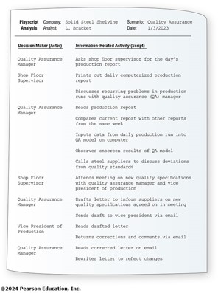
Figure 5.14 A Sample Page from an Analyst’s Playscript Describing Decision Making
Notes:
Long Description:
Top of the page shows the information:
Playscript: Company: Solid Steel Shelving. Scenario: Quality Assurance.
Analysis: Analyst: L. Bracket. Date: 1/3/2023.
Below it, the table shows two columns, depicting Decision Maker (Actor) and Information-Related Activity (Script).
Quality Assurance Manager: Asks shop floor supervisor for the day’s production report.
Shop Floor Supervisor: Prints out daily computerized production report.
Shop Floor Supervisor: Discusses recurring problems in production runs with quality assurance (Q A) manager.
Quality Assurance Manager: Reads production report.
Quality Assurance Manager: Compares current report with other reports from the same week.
Quality Assurance Manager: Inputs data from daily production run into Q A model on computer.
Quality Assurance Manager: Observes onscreen results of Q A model.
Quality Assurance Manager: Calls steel suppliers to discuss deviations from quality standards.
Shop Floor Supervisor: Attends meeting on new quality specifications with quality assurance manager and vice president of production.
Quality Assurance Manager: Drafts letter to inform suppliers on new quality specifications agreed on in meeting.
Quality Assurance Manager: Sends draft to vice president via email.
Vice President of Production: Reads drafted letter.
Vice President of Production: Returns corrections and comments via email.
Quality Assurance Manager: Reads corrected letter on email.
Quality Assurance Manager: Rewrites letter to reflect changes.

Slide 52
S T R O B E (1 of 2)
STRuctured OBservation of the Environment—a technique for observing the decision-maker’s physical environment
Notes:
Observing the physical environment also reveals much about decision makers’ human information requirements.

Slide 53
S T R O B E (2 of 2)
Often it is possible to observe the particulars of the surroundings that will confirm or negate the organizational narrative
  Also called stories or dialogue
  Information that is found through interviews or questionnaires

Slide 54
S T R O B E Elements
Office location
Desk placement
Stationary equipment
Props
External information sources
Office lighting and color
Clothing worn by decision makers
Notes:
These elements can reveal much about the way a decision maker gathers, processes, stores, and shares information, as well as about the decision maker’s credibility in the workplace.

Slide 55
Figure 5.15 Seven Concrete Observable Elements of STROBE
Observable Element | Questions an Analyst Might Investigate
Office location | Who has the corner office? Are the key decision makers dispersed over separate floors?
Desk placement | Does the placement of the desk encourage communication? Does the placement demonstrate power?
Stationary equipment | Does the decision maker prefer to gather and store information personally? Is the storage area large or small?
Props | Is there evidence that the decision maker uses a P C, smartphone, or tablet computer in the office
External information sources | Does the decision maker get much information from external sources such as trade journals or the Web?
Office lighting and color | Is the lighting set up to do detailed work or more appropriate for casual communication? Are the colors warm and inviting?
Clothing worn by decision makers | Does the decision maker show authority by wearing conservative suits? Are employees required to wear uniforms?

Slide 56
Figure 5.16 S T R O B E and Decision-Maker Characteristics
Characteristics of Decision Makers | Corresponding Elements Characteristics of Decision Makers in the Physical Environment
Gathers information informally | Warm, incandescent lighting and colors
Seeks extraorganization information | Trade journals present in office
Processes data personally | P Cs, or tablet computers present in office
Stores information personally | Equipment/files present in office
Exercises power in decision making | Desk placed for power
Exhibits credibility in decision making | Wears authoritative clothing
Shares information with others | Office easily accessible

Slide 57
Applying S T R O B E
The five symbols used to evaluate how observation of the elements of S T R O B E compared with interview results are:
  A checkmark means the narrative is confirmed
  An “X” means the narrative is reversed
  An oval or eye-shaped symbol serves as a cue to look further
  A square means observation modifies the narrative
  A circle means narrative is supplemented by observation
Notes:
One way to implement STROBE is through the use of an anecdotal checklist with meaningful shorthand symbols.

Slide 58
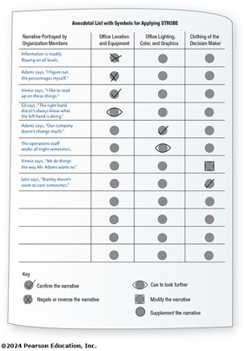
Figure 5.17 An Anecdotal List with Symbols For Use in Applying S T R O B E
Notes:
Long Description:
The following symbol key depicts:
Check-mark symbol: Confirm the narrative.
Cross symbol: Negate or reverse the narrative.
Eye symbol (horizontal oval over symbol): Cue to look further.
Square symbol: Modify the narrative.
Circle symbol: Supplement the narrative.
The table shows an Anecdotal list with symbols for applying STROBE. There are four columns in the table, with column heads, narrative portrayed by organization members, office location and equipment, office lighting, color and graphics, and clothing of the decision maker. Under each entry in each row is a gray circle for the user to mark.
Information is readily flowing on all levels: Cross symbol: blank circle; blank circle.
Adams says, "I figure out the percentages myself.": Cross symbol; blank circle; blank circle
Vinnie says, “I like to read up on these things.”: Check symbol; blank circle; blank circle
Ed says, “The right hand doesn’t always know what the left hand is doing.”; Eye symbol; blank circle: blank circle.
Adams says, “Our company doesn’t change much.”: blank circle; Check symbol; blank circle.
The operations staff works all night sometimes: blank circle; Eye symbol;
Vinnie says, “We do things the way Mr. Adams wants to.” blank circle; blank circle; Square symbol.
Julie says, “Stanley doesn’t seem to care sometimes.” blank circle; blank circle: Check symbol.

Slide 59
Summary (1 of 2)
Sampling
  Determine population
  Determine types of samples
  Calculate sample size
  Plan data needed to be collected
Hard data
  Quantitative document analysis
  Qualitative document analysis

Slide 60
Summary (2 of 2)
Process mining
Task mining
Workforce analytics
Observation
Text analytics
S T R O B E
  S T R O B E elements
  Applying S T R O B E

Slide 61

Copyright
This work is protected by United States copyright laws and is provided solely for the use of instructors in teaching their courses and assessing student learning. Dissemination or sale of any part of this work (including on the World Wide Web) will destroy the integrity of the work and is not permitted. The work and materials from it should never be made available to students except by instructors using the accompanying text in their classes. All recipients of this work are expected to abide by these restrictions and to honor the intended pedagogical purposes and the needs of other instructors who rely on these materials.

